Slide 1
Forward Pass, Activation Functions And Loss Functions

Slide 2
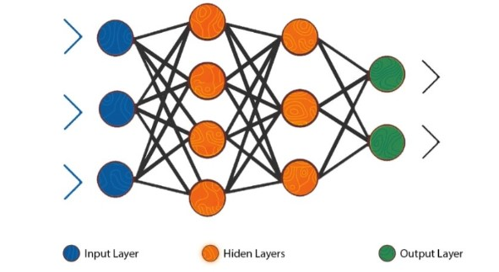
MLP Notation

Slide 3
1. Forward Propagation
Forward propagation is the process by which input data moves through the layers of a neural network to produce an output (a prediction). It’s called “forward” because data flows in one direction — from input layer → hidden layer(s) → output layer, without looping back.

Slide 4
Formula for FP
Mathematically:
z=W⋅x+b
a = f(z)
where:
x = input
W = weight matrix
b = bias
f(⋅)= activation function
a = output (activation)

Slide 5
Forward pass for an MLP
If we have one hidden layer and one output layer the prediction will go this way:
z1 = w1x + b1
a1 = f(z1)
z2 = w2a1 + b2
y^ = f(z2)

Slide 6
Why It’s Used
Forward propagation is how a network makes predictions. It’s the core mechanism during both training and testing.
During training, forward propagation gives us predicted outputs, which are then compared with true labels using a loss function.
Without forward propagation, the network has no way to evaluate its performance or update its parameters.

Slide 7
Activation Functions
What id NON-LINEARITY?

Slide 8
The Exercise Analogy
Linear:
30 min exercise = 1 unit fitness, 60 min exercise = 2 units fitness
Non-linear:
First 30 min exercise = 2 unit (big gain), next 30 min exercise = 0.6 units (smaller gain), after 2 hours = possible injury

Slide 9
Activation functions
An activation function decides whether a neuron should activate (fire) or not. It takes the neuron’s input (weighted sum) and applies a mathematical transformation, introducing non-linearity into the model.
Without activation functions, a neural network would behave like a simple linear regression model — no matter how many layers it has.

Slide 10
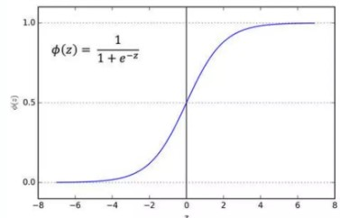
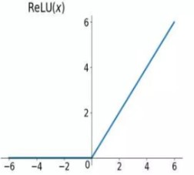
Activation Functions
Sigmoid
Relu
f(x)=1 / 1+e−x​
f(x)=max(0,x)

Slide 11
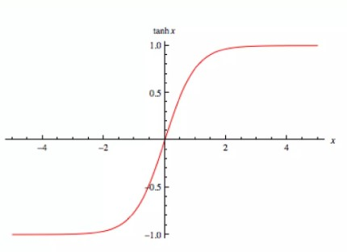
Activation functions
Tanh
f(x)=tanh(x)

Slide 12
Activation Function Usage
model1 = Sequential([
Dense(3, input_dim=2, activation='relu'),
Dense(1, activation='sigmoid')
])

Slide 13
Loss Functions
A loss function (also called cost function) measures how far the model’s predictions are from the actual target values.
It gives the network a sense of error — telling it how “bad” or “good” its predictions are. The smaller the loss, the better the model’s performance.
Mathematically:
L=Loss(Ytrue,Ypred​)

Slide 14
Loss Functions
Type | Common Loss | Used For
Regression | Mean Squared Error (MSE) | Predicting continuous values
Binary Classification | Binary Cross-Entropy | 2-class problems
Multi-Class Classification | Categorical Cross-Entropy | 3+ classes
Multi-Label | Binary Cross-Entropy | Multiple true labels
MAE | Mean Absolute Error

Slide 15
Loss Function Usage
model.compile(optimizer='adam', loss=‘any loss function', metrics=['accuracy'])

